Slide 1
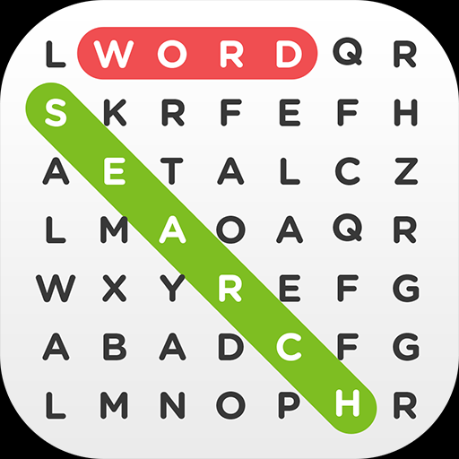
WORD SEARCH

Slide 2
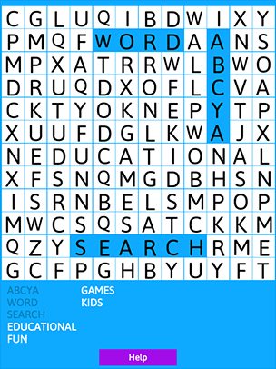
word search is a puzzle is a word game that consists of the letters of words placed in a grid, which usually has a rectangular or square shape. The objective of this puzzle is to find and mark all the words hidden inside the box. The words may be placed horizontally, vertically, or diagonally.

Slide 3
Working out puzzles reinforces the existing connections between our brain cells and boosts the generation of new relationships, both of which greatly enhance our mental speed and thought process. It is also a verified fact that puzzles are beneficial for every age, seeing that the young possess highly malleable minds while adults and seniors are more vulnerable to recollection difficulties.

Slide 4
How the app works?
This app has 3 categories of word search .
If it is difficult to find an answer , there is a hint button which will provide you a clue as to where the answer could be .
There will be a timer which will be set , and you have to complete the word search before it goes off or else the game will be over.

Slide 5
Components
Label
Drawing canvas
Clock
Button
Table arrangement
Texttospeech

